Slide 1
Welcome to CGT 575 Data Visualization Tools & Applications 2023 spring
Week 11- Lecture 2

Slide 2
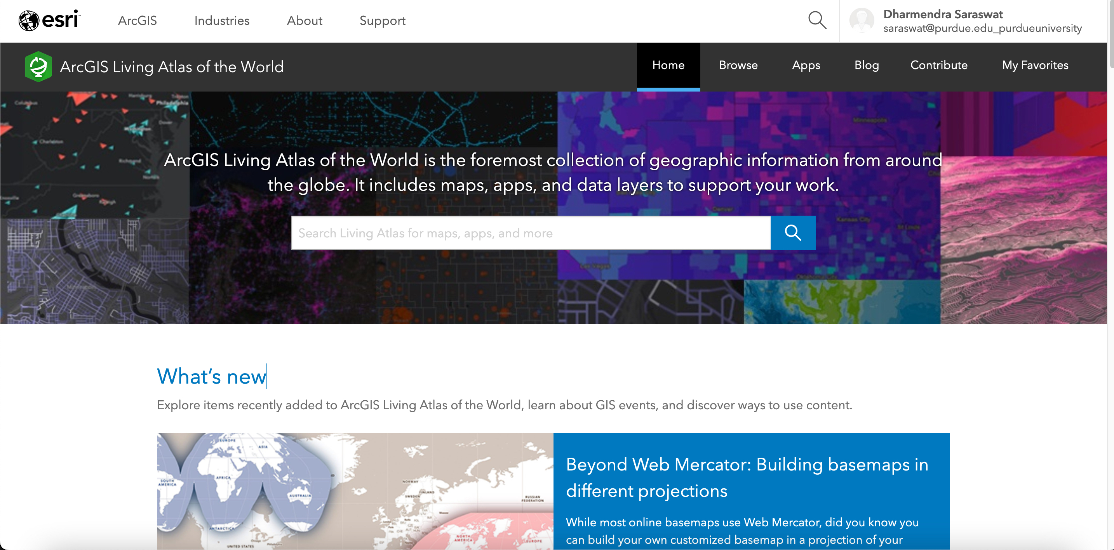
ArcGIS Living Atlas of the World

Slide 3
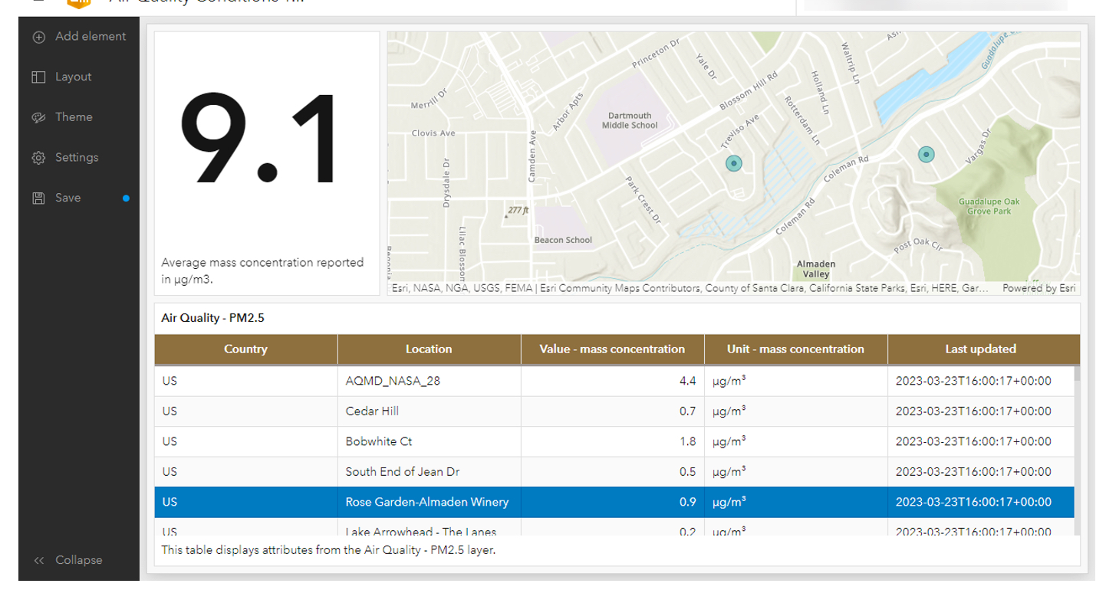
ArcGIS Living Atlas of the World-Exercise
Air Quality Indicator Map

Slide 4
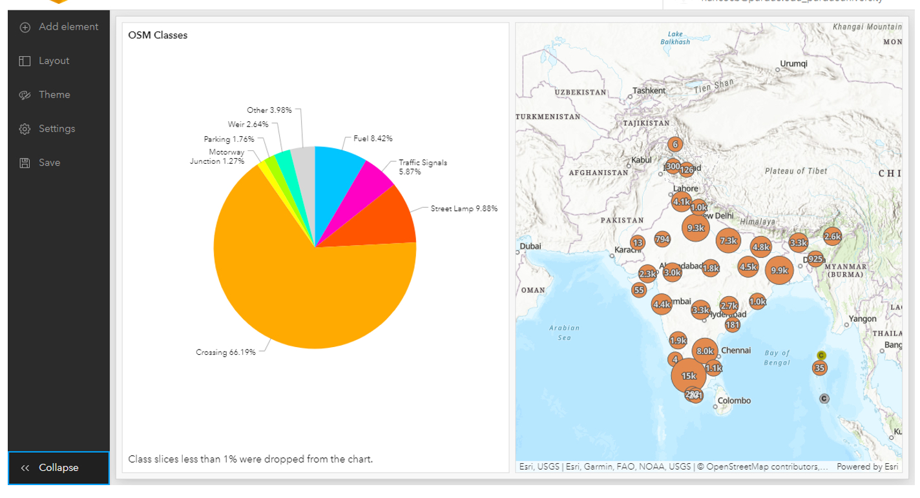
ArcGIS Living Atlas of the World-Exercise
OSM Traffic in India Map

Slide 5
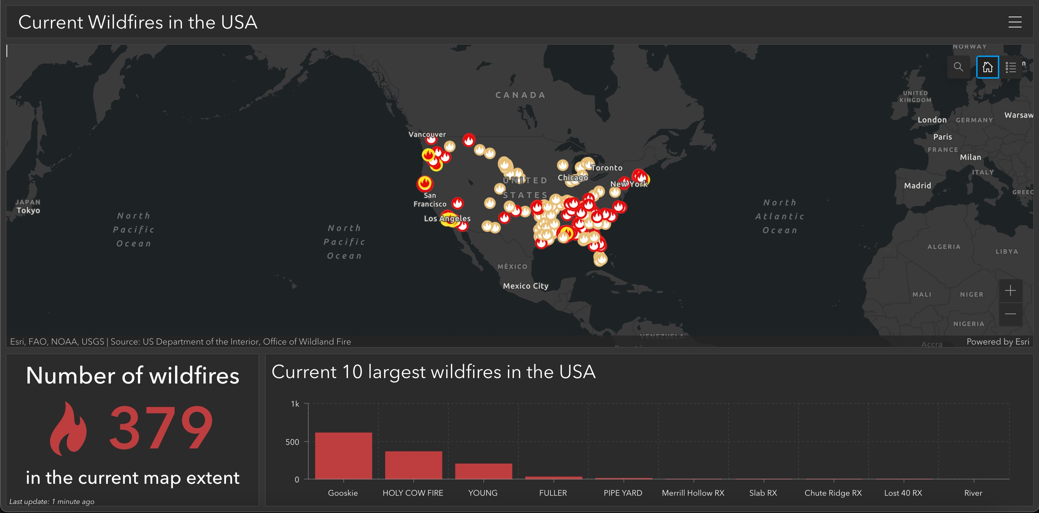
ArcGIS Living Atlas of the World-Exercise
make-a-dashboard-to-monitor-wildfires/

Slide 6
Thank You

